Slide 1

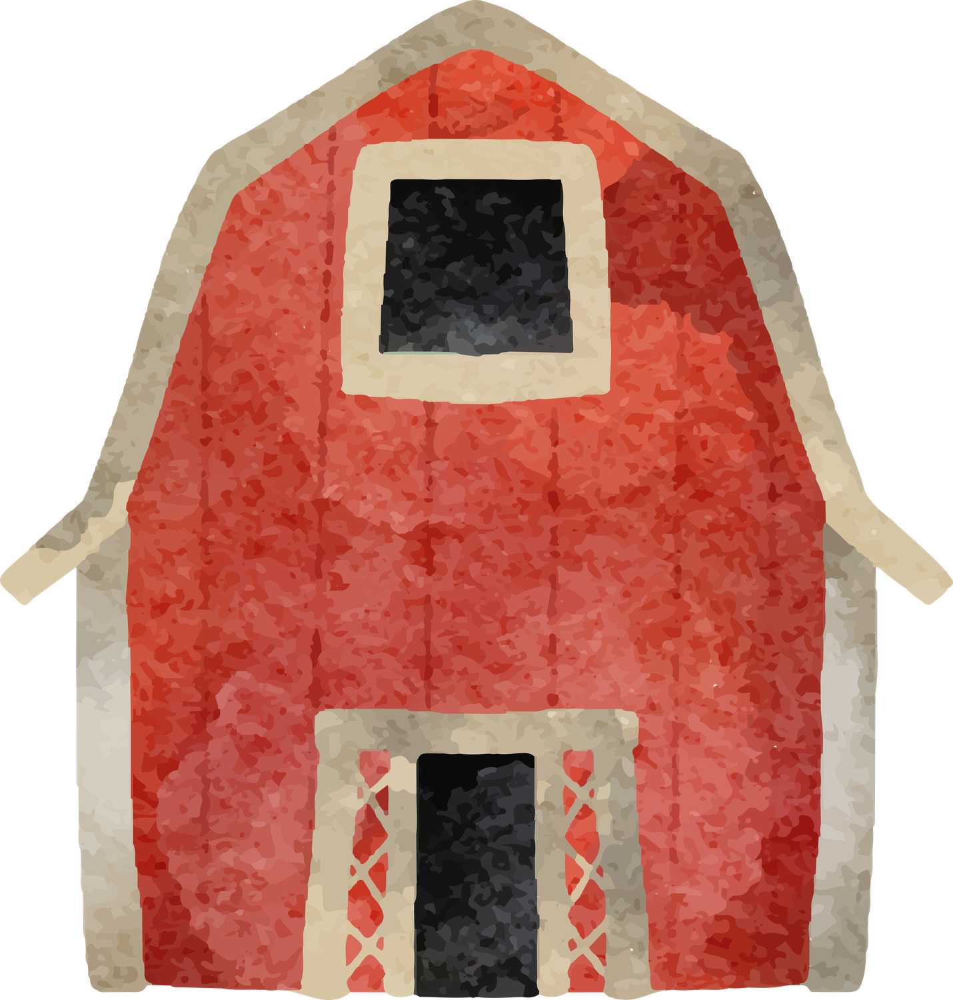
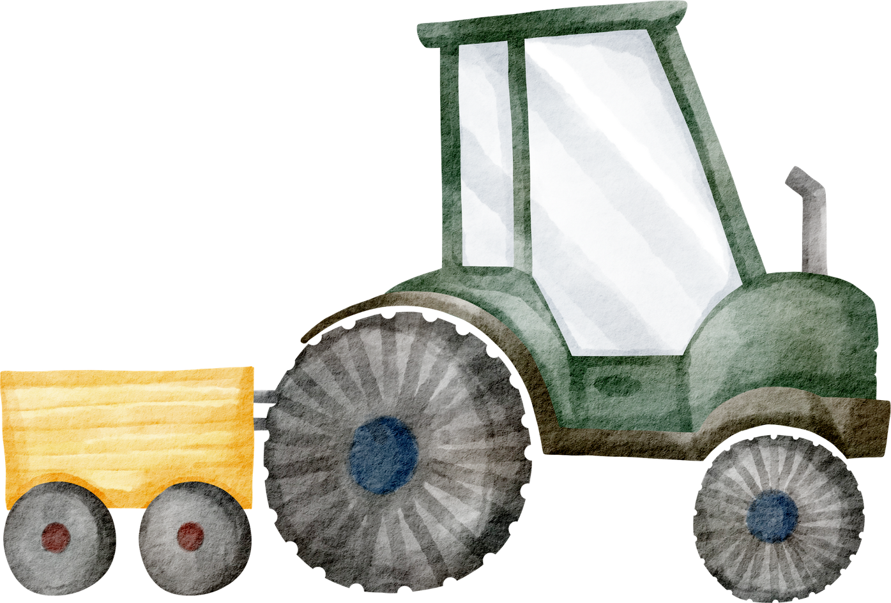
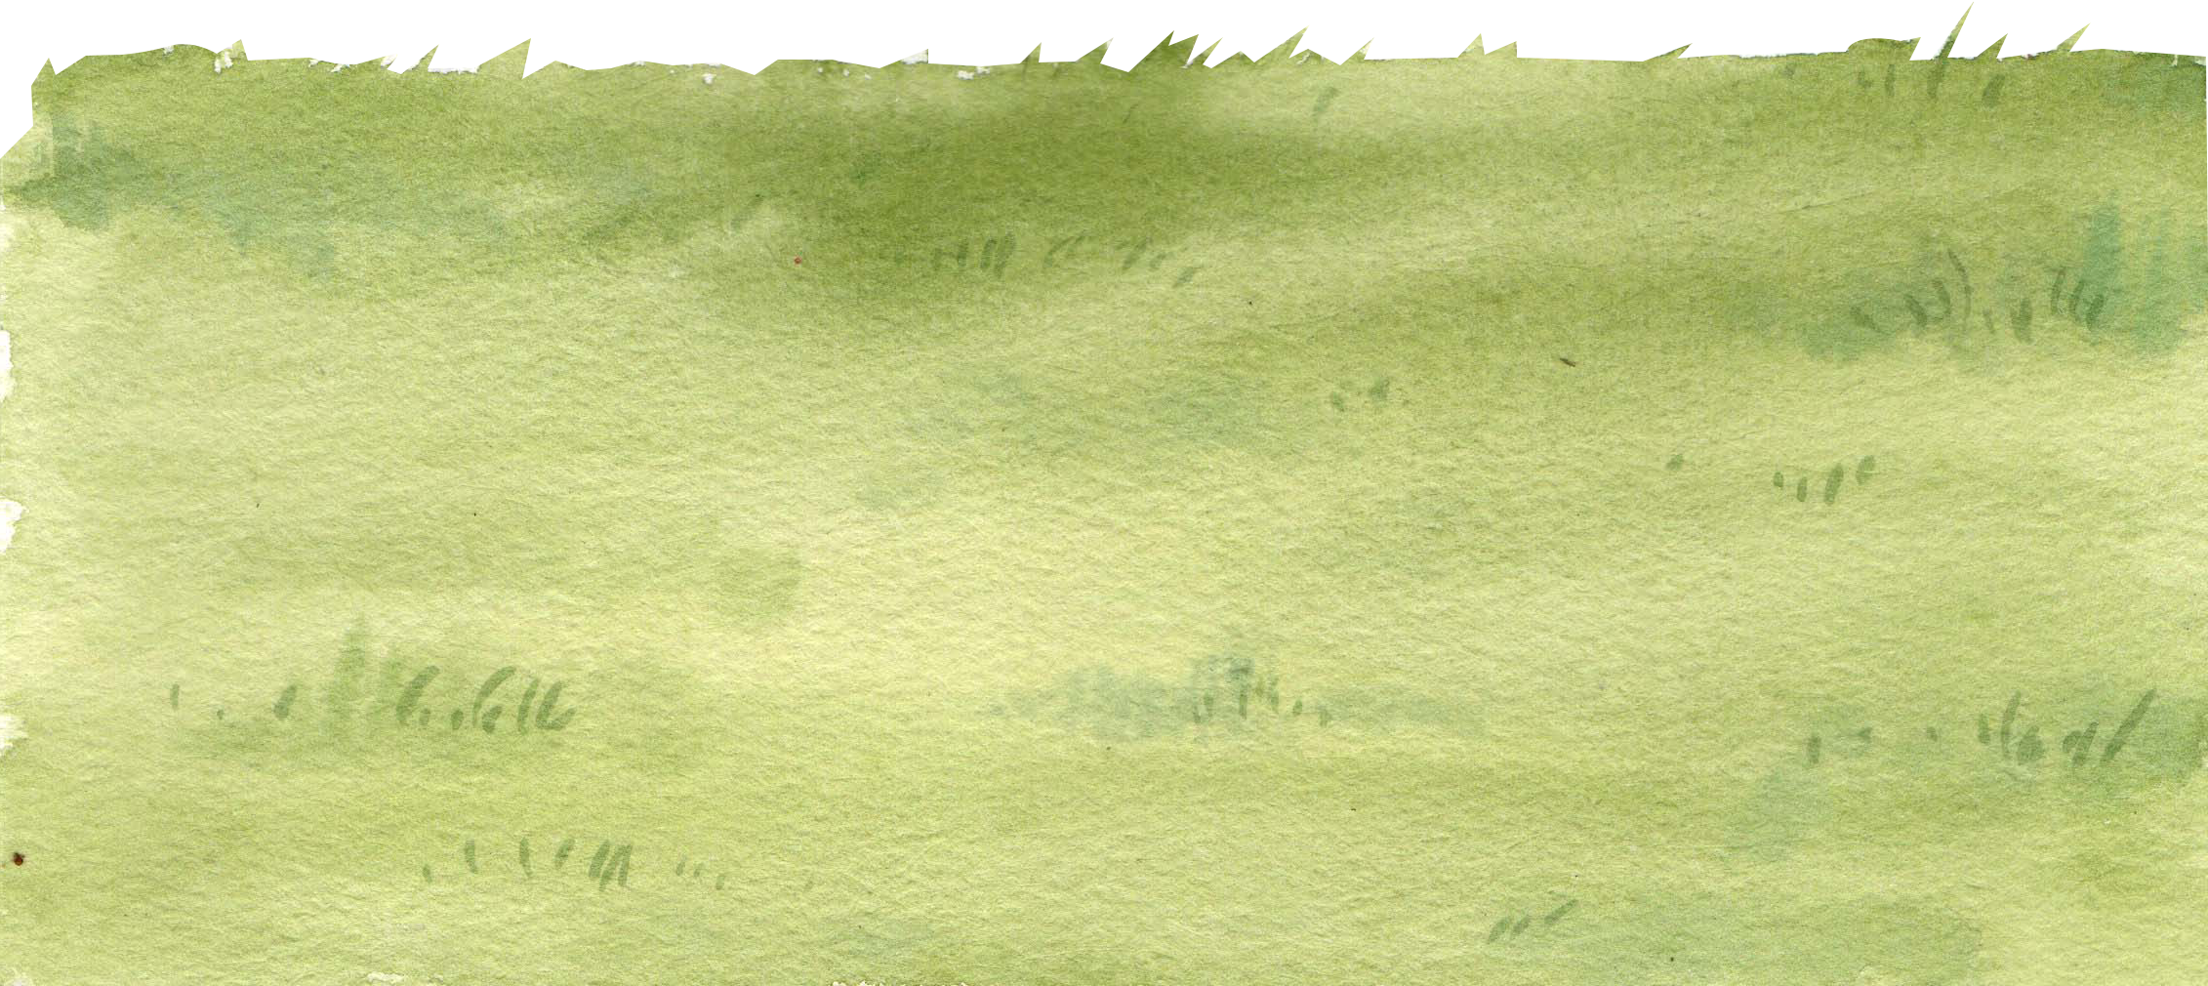
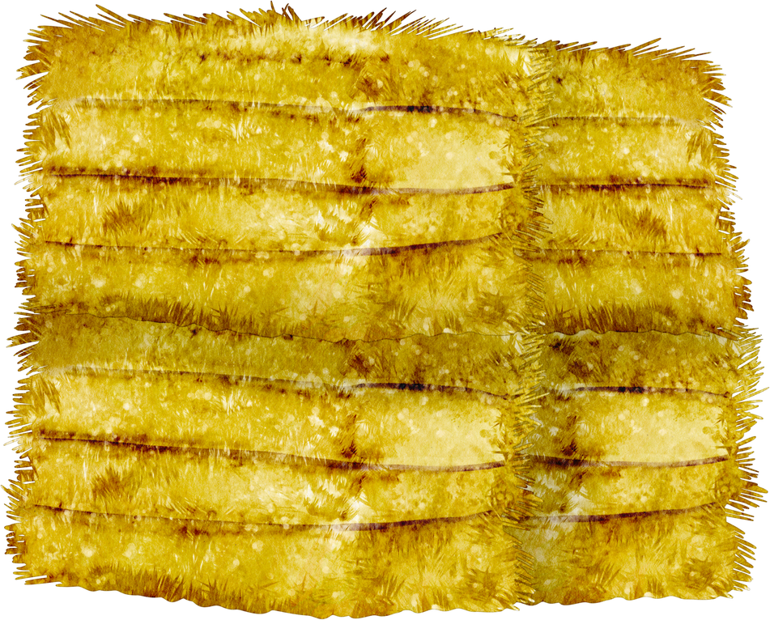
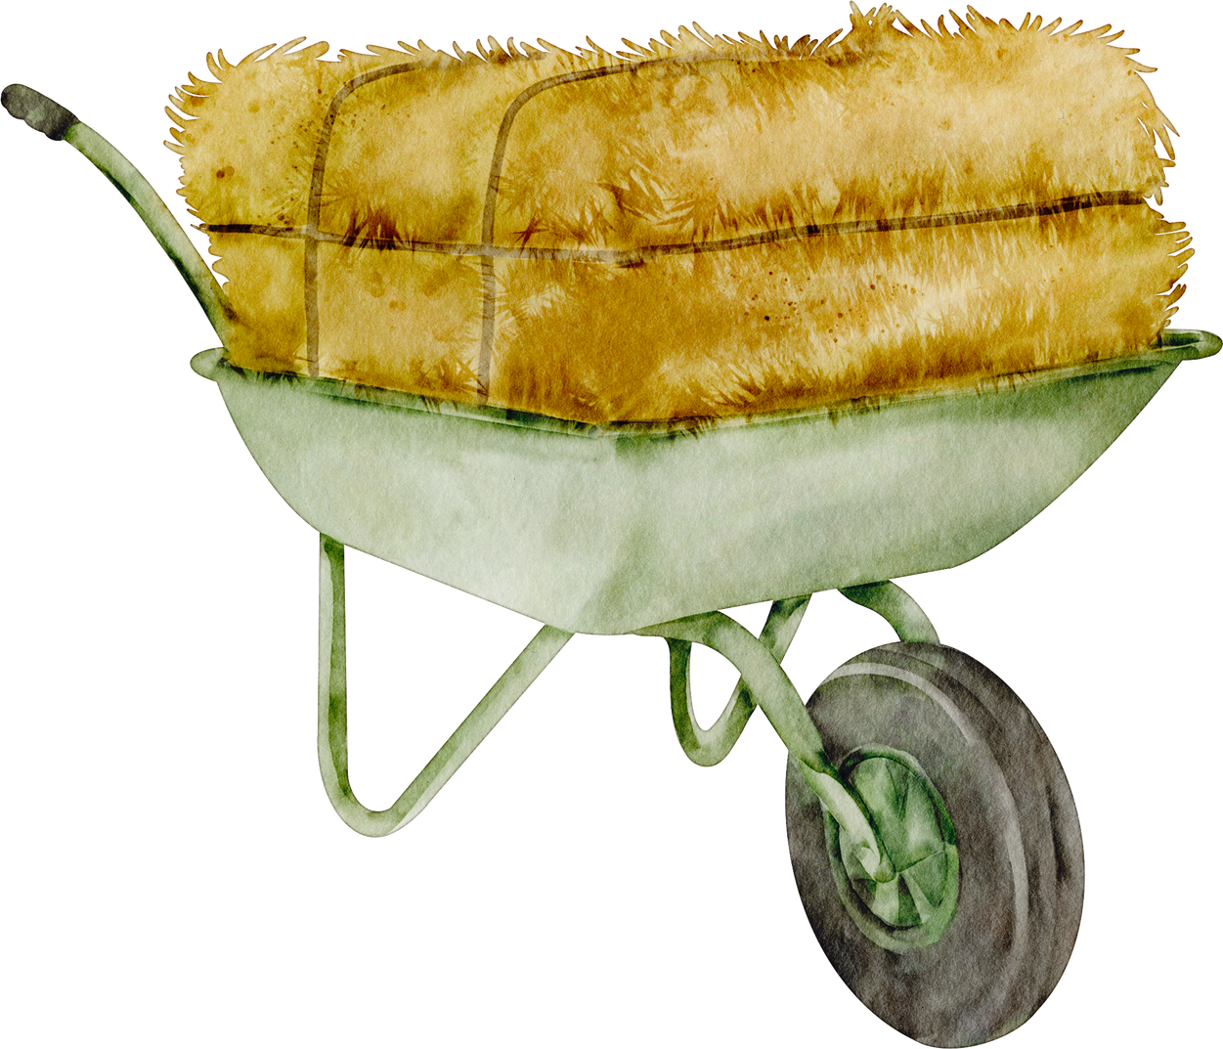

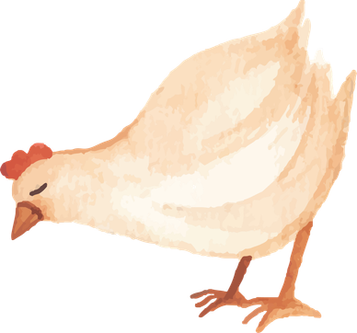
DROUGHT
LENS
BY: TEAM WOLVERINE

Slide 2
BACKGROUND + ISSUE
Corn and soybean farmers in Iowa and Nebraska need a way to estimate potential crop yield losses because the same drought severity can have different impacts depending on irrigation, drought timing, and location. We propose a data-driven dashboard that uses historical agricultural data to provide understandable yield estimates and support better farming decisions included with an agricultural advisor.

Slide 3
USERS AND GOALS
Farmers in Iowa and Nebraska who are growing corn and soybeans, especially in areas of the Midwest where drought is common.
Our goal is to help farmers understand the potential effects of an approaching drought and what they can do to prepare for future droughts.
We want to show how much yield loss a drought could cause so they can make informed decisions on how to prepare for times of need.

Slide 4
THE DECISIONS
Our decision is to create a web app that helps farmers understand the historical impact of drought and calculate comparisons for both Iowa and Nebraska, including the differences between irrigated and non-irrigated areas.
With the results given, the farmer can then decide how much to prepare for a future drought, whether to raise crop insurance, plan irrigation early, line up grain storage, or change how much grain to contract.

Slide 5
WHY WE BUILT IT
The reason why we built this is because farmers can get a bigger picture on the effects of drought on crop yields based on the evidence provided.

Slide 6
THANK YOU

